Slide 1
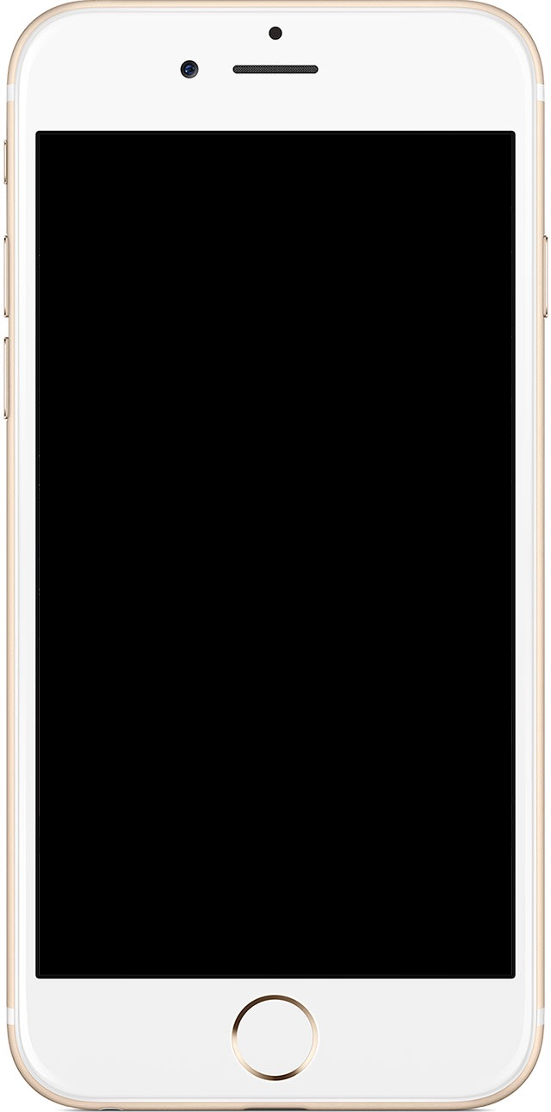
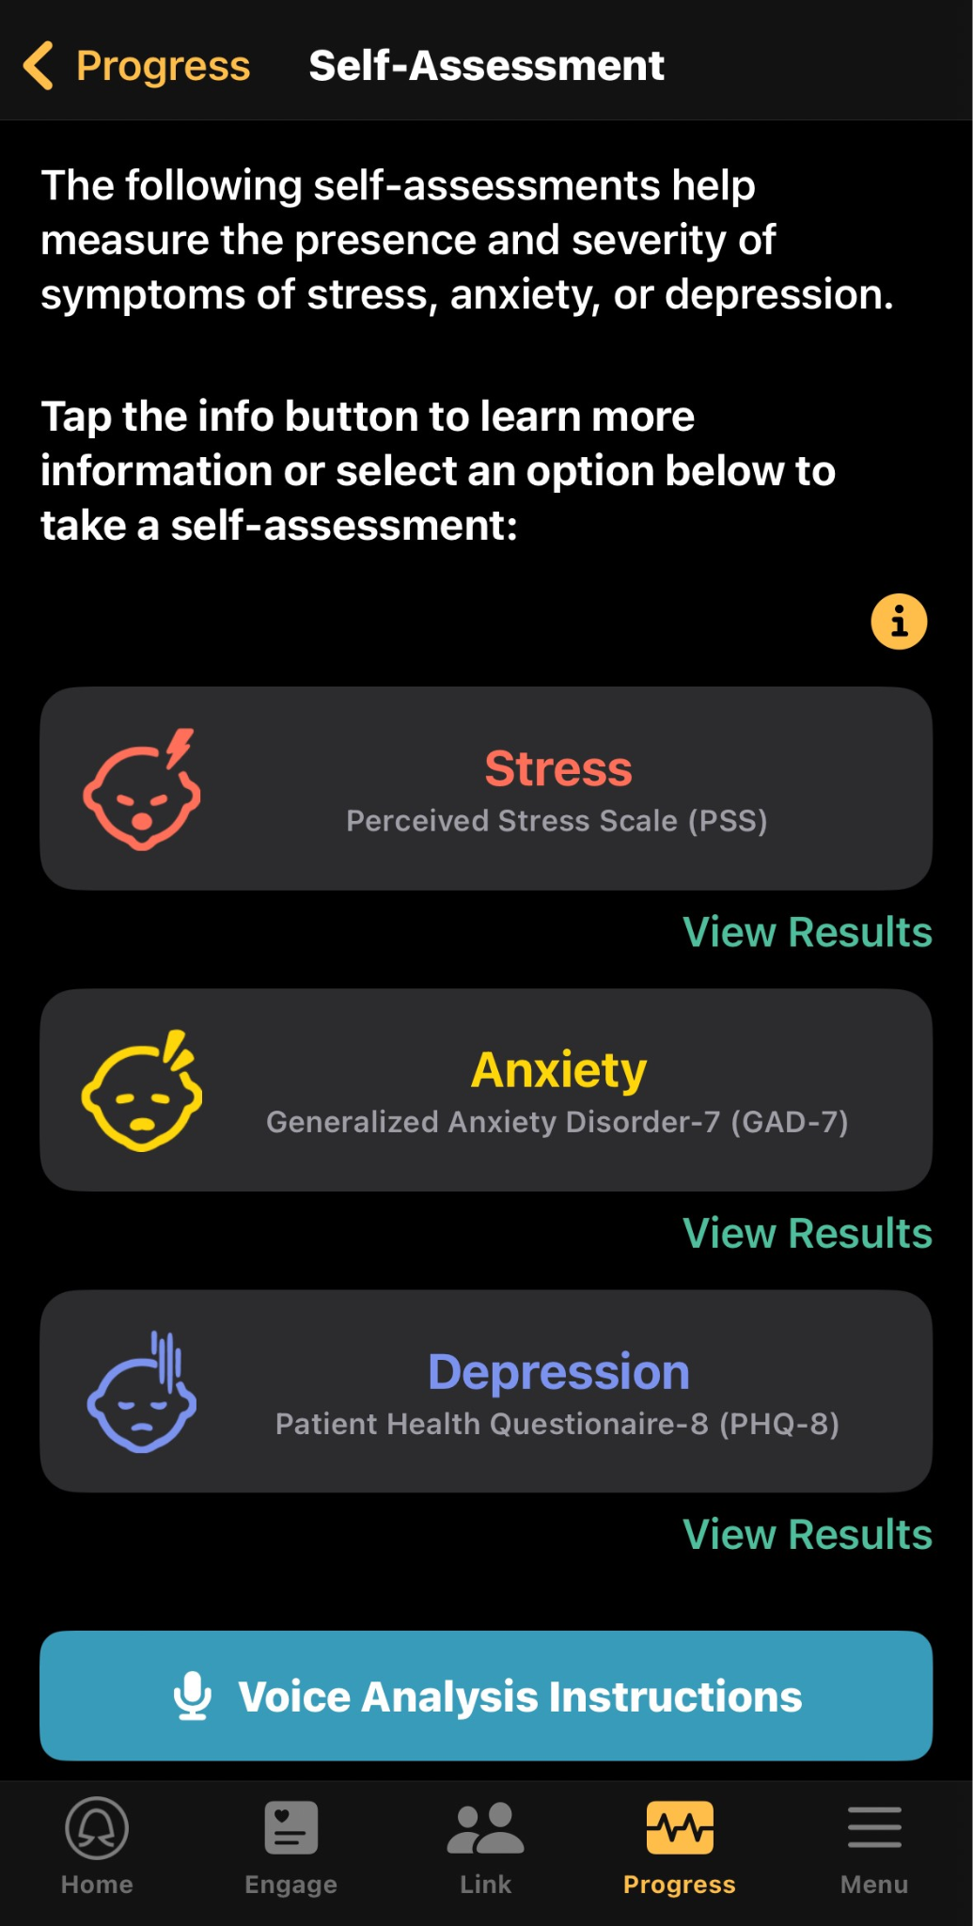
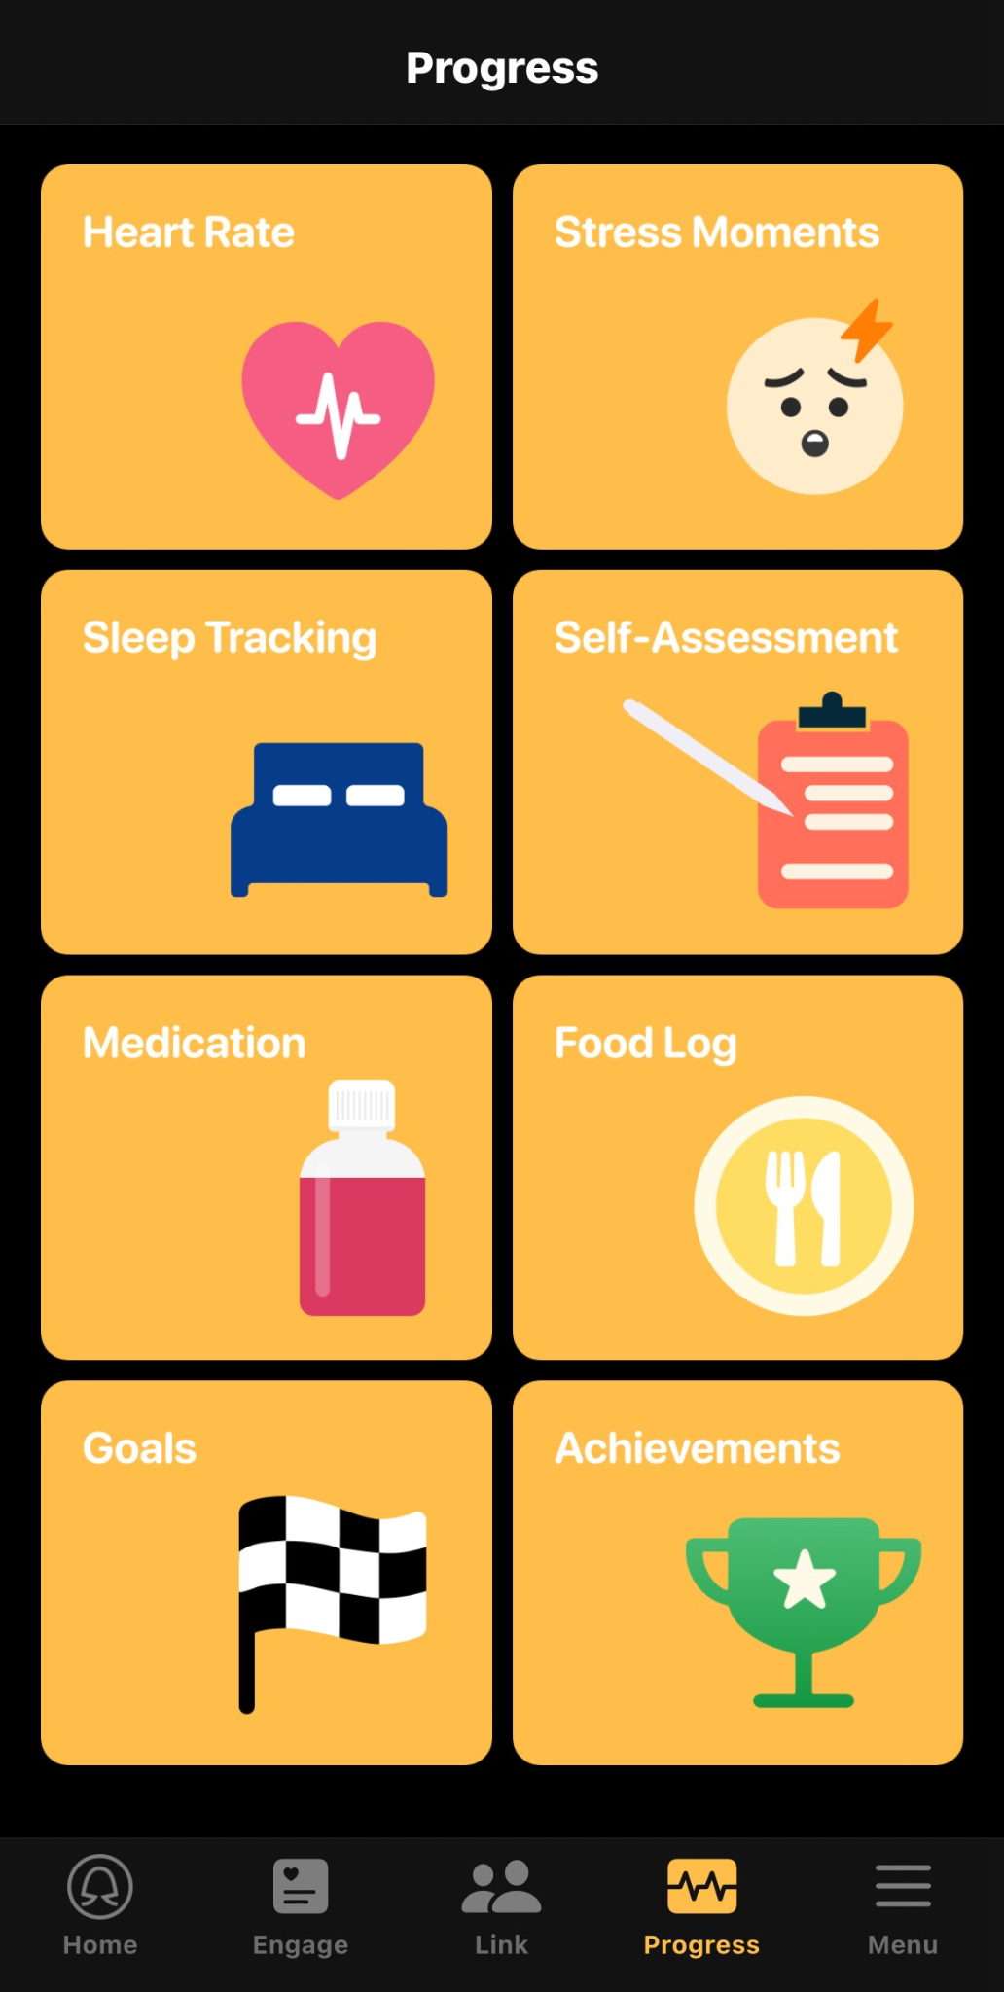
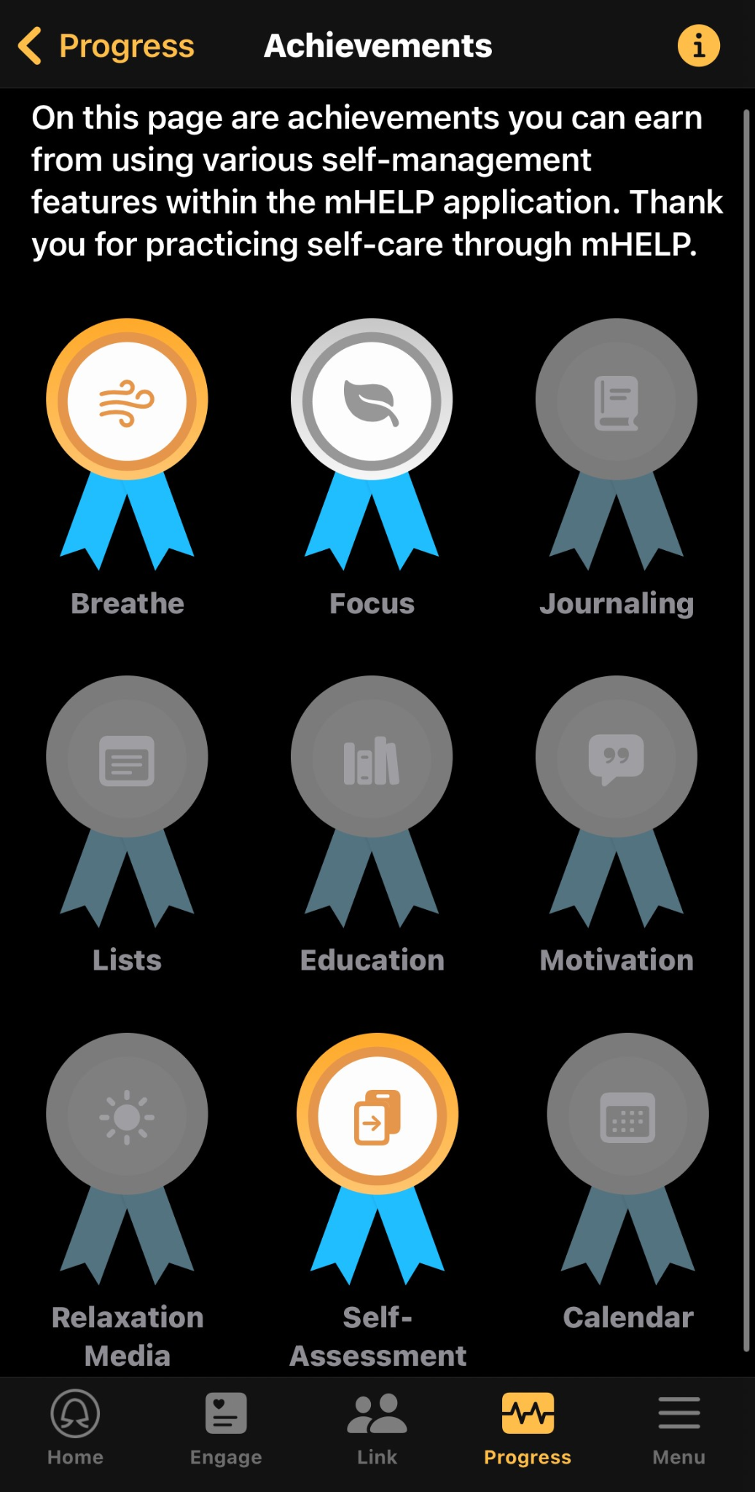
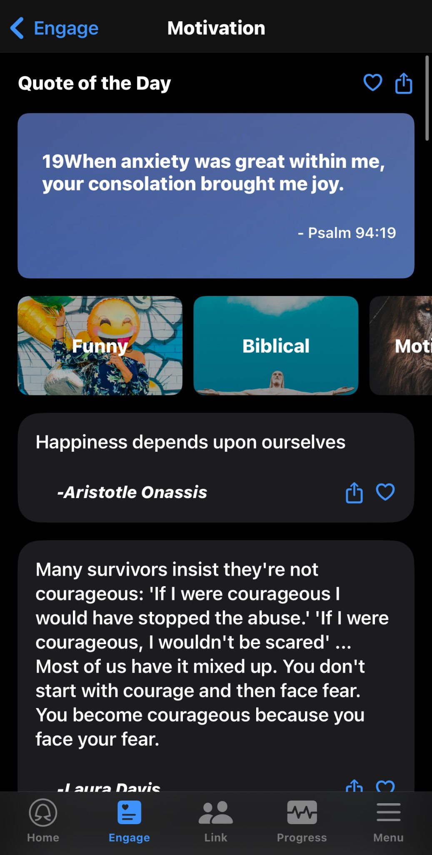
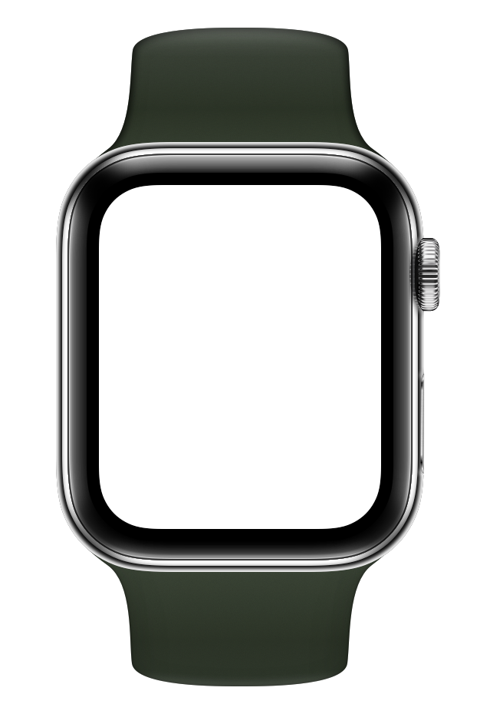
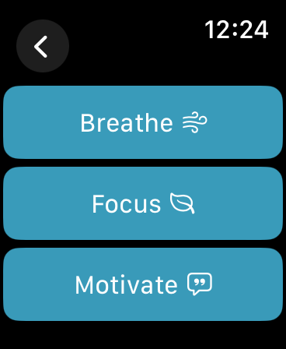
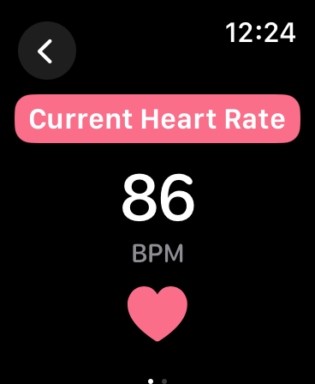
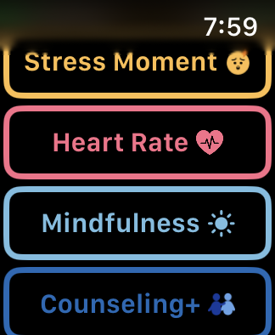
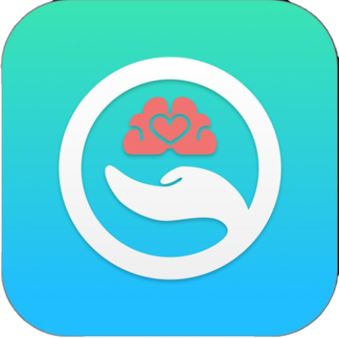

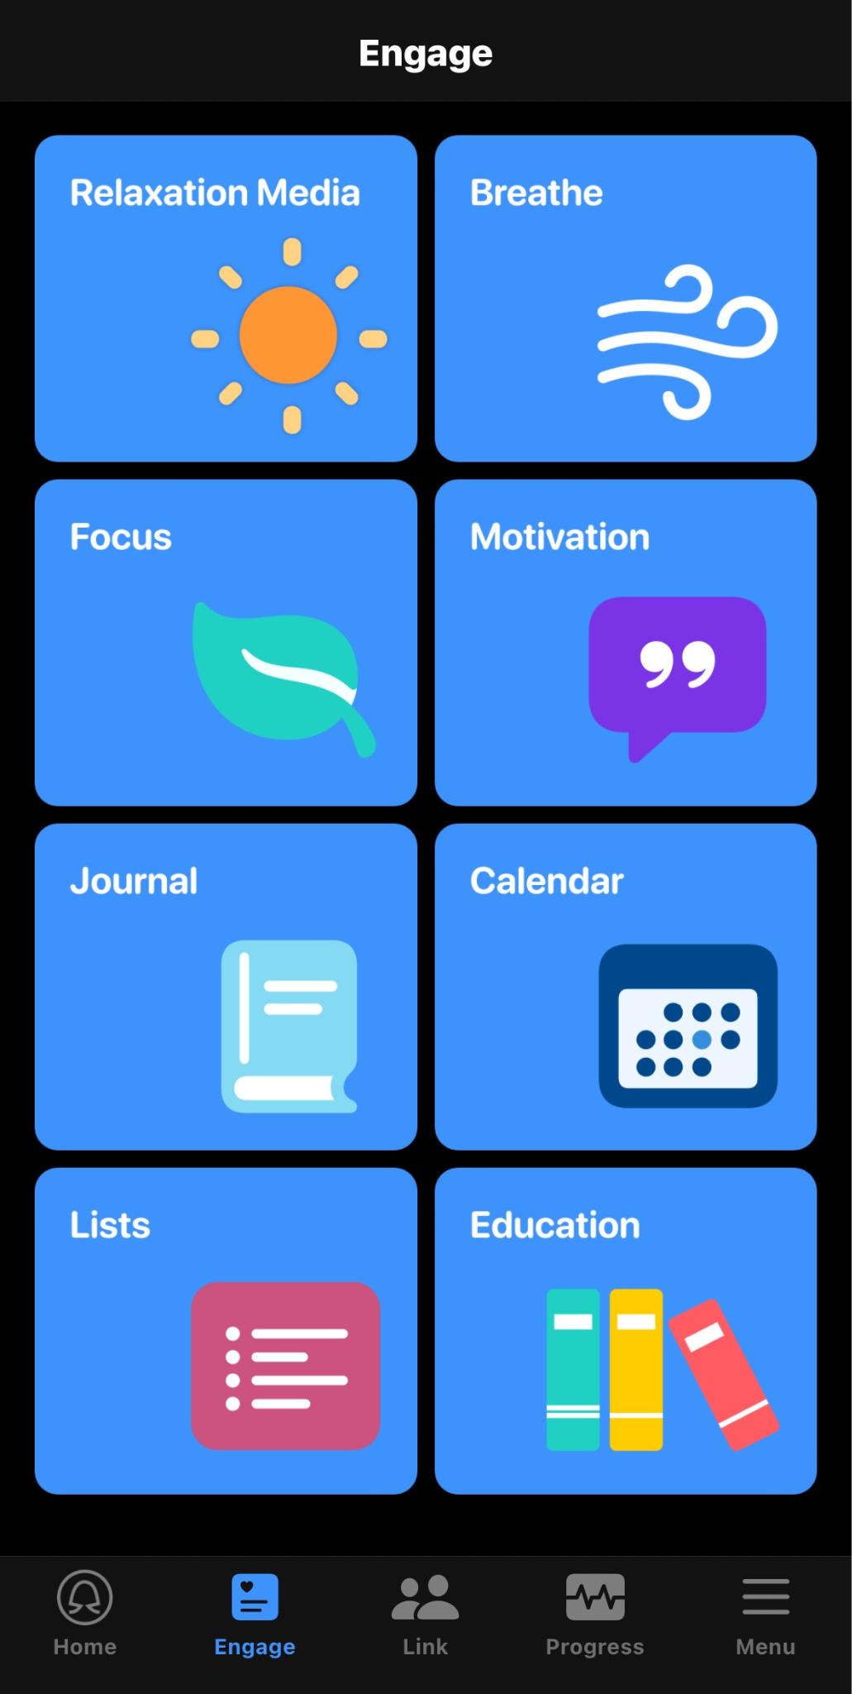
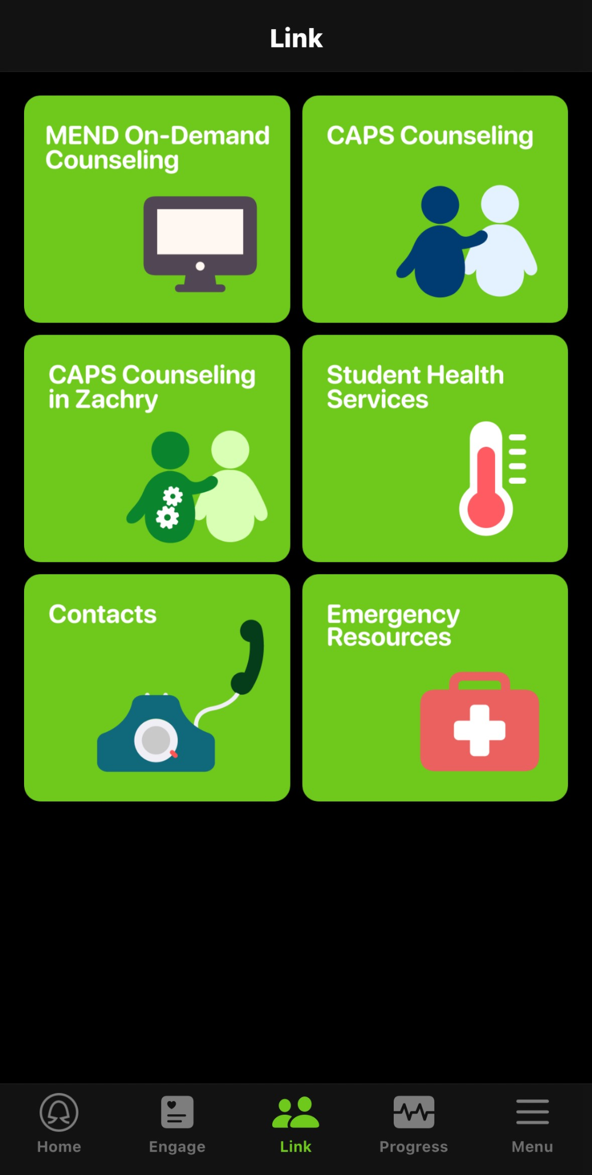
Smart Pest Repeller
Andrew Albritton, Michael McNeil, Melquisedec Ordonez
Faculty Member: Peng Hao Huang
¹ Department of Industrial and Systems Engineering, Texas A&M University ² Center for Remote Health Technologies and Systems, Texas A&M University
³ VA VISN17 Center of Excellence for Research on Returning War Veterans ⁴ Department of Health Policy & Management, Texas A&M University
⁵ VA Boston Healthcare System ⁶ College of Medicine, Texas A&M University
Background
University students frequently experience feelings of stress and anxiety. In one research, out of a random sample of 500 college students, 88.4% of students experienced anxiety, 46.8% of these students experienced severe anxiety, and 84.4% of students experienced stress.¹
These metrics show that stress and anxiety are prevalent mental disorders found in college students. mHELP (Mental Health Evaluation and Look out Program) is a mobile health tool designed to enable self-management of stress and anxiety among college students.
Figure 2: Heart Rate Monitor
Figure 5: Watch Functions
Research Aims
Figure 4: Mobile App Activities
Texas A&M University plans to release the app to students attending the university, so students can use the app for mental health self management. It is our hope that the research we are conducting will provide valuable insight into how we can make the app better more accessible to students.
Future Work
The purpose of this evaluation is to test the accessibility of the mHELP app on both the iPhone and the watch and see how students integrate the app into their daily lives.
Similarly, we will be documenting the accuracy of the stress detection machine learning model found in the Apple Watch.
To receive data, we will ask around 30 college students to test out the app during the month of April.
Methods
The method of this research is focused into two categories: The mobile app and the apple watch.
Mobile App:
The mobile app provides various functionalities, such as stress detection, focus enhancement, breathing exercises, motivational aids, heart rate monitoring, and access to counseling resources.
Throughout the user’s experience, the user is given simple tasks to perform to help them focus as well as relax. There is also a self-assessment section allowing for evaluation of stress (PSS), depression (PHQ-8) and anxiety(GAD-7).
The mobile app lets users view their progress over a period of time.
Apple Watch:
The apple watch let’s users track their progress which is then synced into the mobile app.
The user will be notified when their heart rate becomes elevated or when stress is detected.
The apple watch provides access to mindfulness, counseling, and motivation quotes. As well as tools such as Breath and Focus to assist the user in lowering their heart rate.
Figure 6: App Home Screen Emblems
Figure 3: Home Page for the watch
Sources
Anticipated Results
Data will be anonymously acquired from each subject during the evaluation period. There will also be an exit interview given to each participant when the evaluation period finishes.
1 Asif S, Mudassar A, Shahzad TZ, Raouf M, Pervaiz T. Frequency of depression, anxiety and stress among university students. Pak J Med Sci. 2020 Jul-Aug;36(5):971-976. doi: 10.12669/pjms.36.5.1873. PMID: 32704273; PMCID: PMC7372668.
Stress Detection Model:
Model accuracy will be evaluated at the end of the study using subjects’ personal experience with correlating stress moment data.
With this evaluation we will be able to adapt the model to achieve higher performance.
Daily Usage Habits and Focus Areas:
Using survey statistics and daily journal entries outlining their experience, we will evaluate how the users interact with the app’s various features.
The data will determine which methods are effective and which methods will need further attention.
Figure 1: The features included in the mobile app
Notes:
The Subtitle Title sections can be replaced with images as needed, and vice versa.

